Slide 1



Lava Flow Simulation

Slide 2
Why lava flows ?

Slide 3
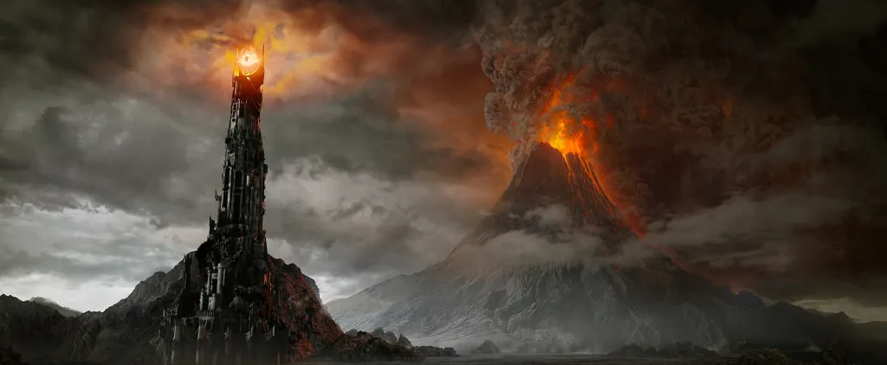
Why lava flows ?
- Entertainment

Slide 4
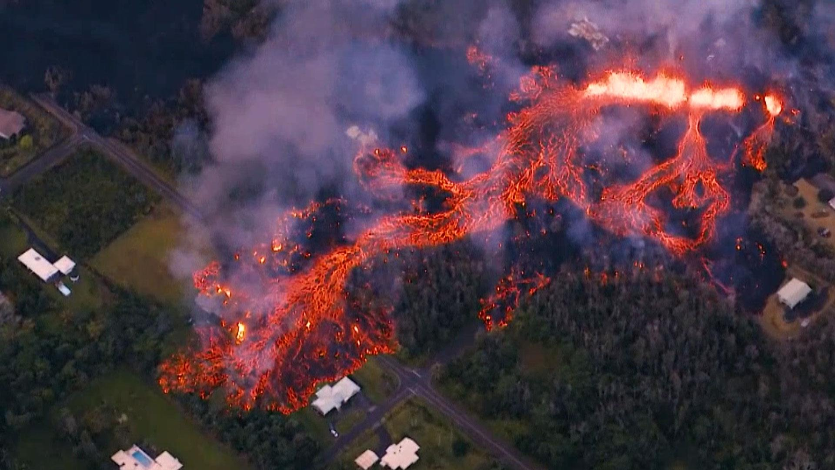
Why lava flows ?
- Entertainment
- Prevention

Slide 5
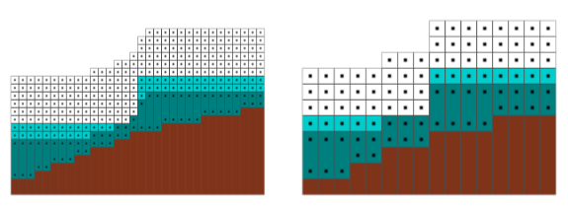
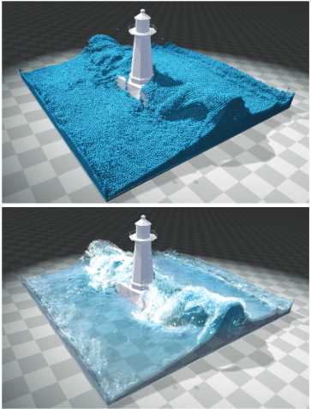
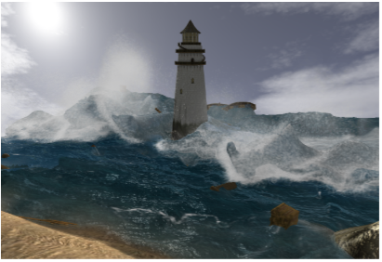
Existing methods: Fluid simulation
Eulerian models
Lagrangian models
from Real-Time Eulerian Water Simulation Using a Restricted Tall Cell Grid, Müller et al.
from SPH Fluids in Computer Graphics, Ihmsen et al.

Slide 6
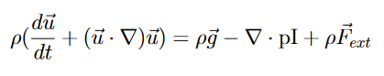
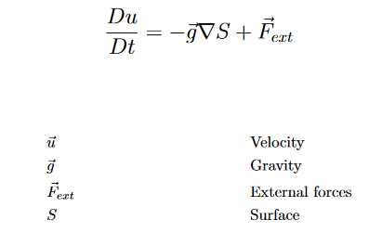
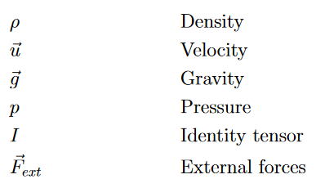
Existing methods: From 3D to 2D
3D Navier-Stokes Equation
2D Shallow Water Equations

Slide 7
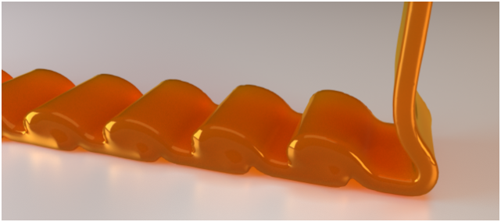
Existing methods: Viscosity
Explicit schemes
Implicit schemes
x(t+dt) = f(x(t))
+ Fast per time step
Needs small steps to be stable
Steps sizes depends on 1/viscosity
x(t+dt) = f(x(t+dt), x(t))
+ Time step size independent
- Linear system to solve
from A Physically Consistent Implicit Viscosity Solver for SPH Fluids, Weiler et al.

Slide 8
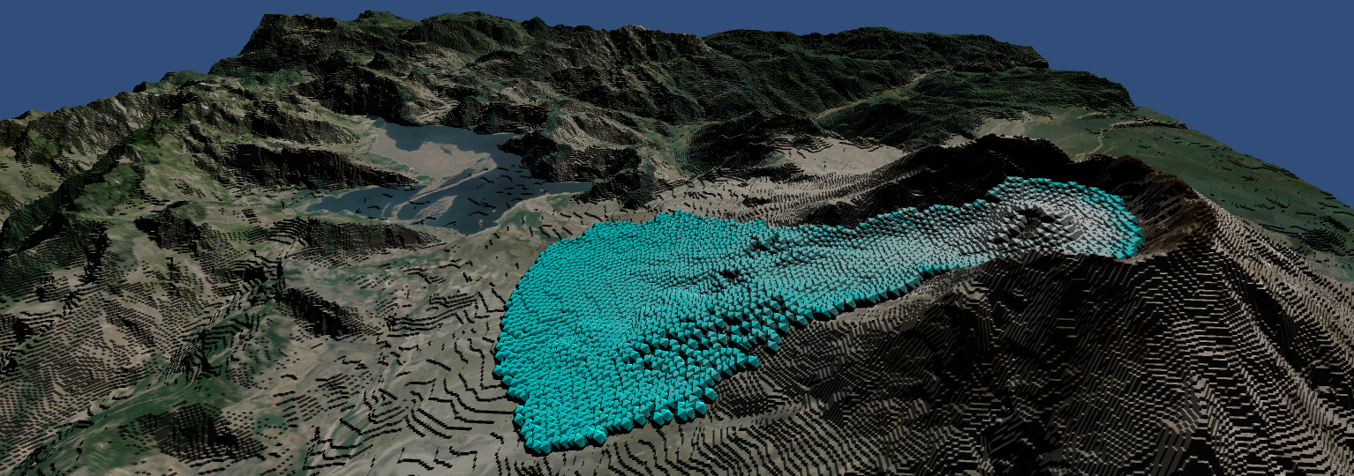
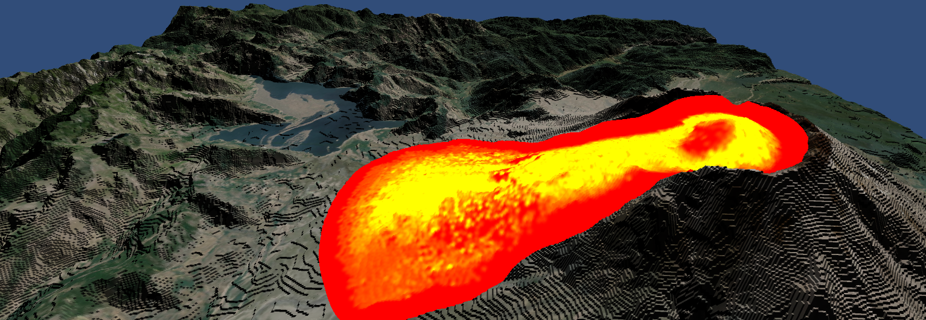
Our method

Slide 9
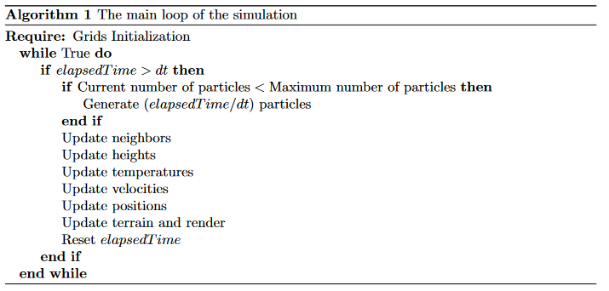
The algorithm

Slide 10
The algorithm

Slide 11

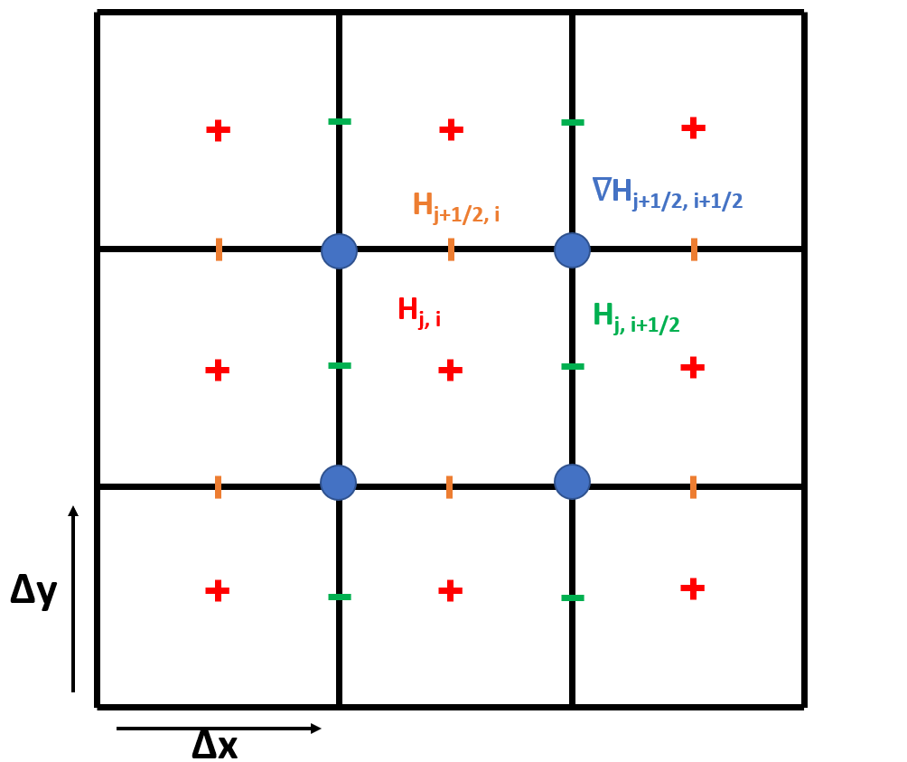
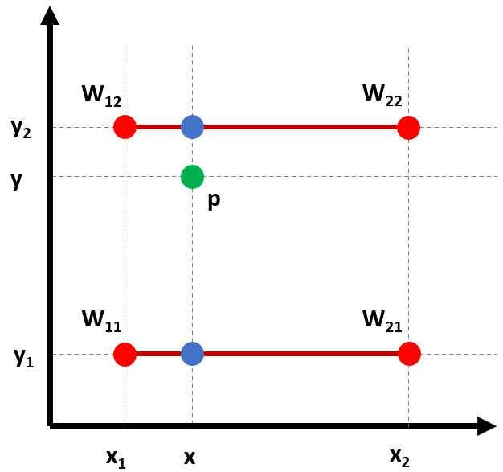
The Staggered grid
Heightmap
Staggered grid
Interpolation

Slide 12
The algorithm

Slide 13
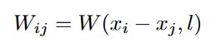
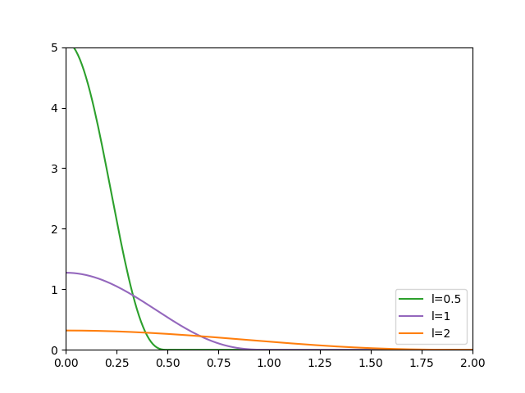
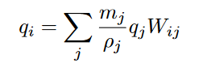
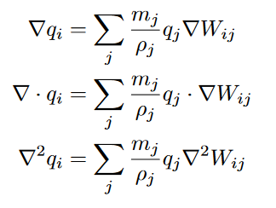
Smoothed Particle Hydrodynamics
3D Version
i
Usual Smoothing kernel : Wpoly6

Slide 14
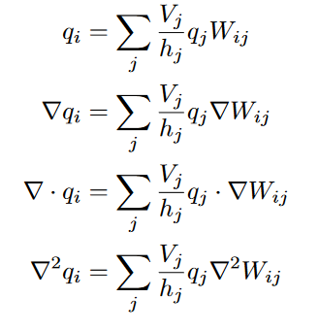
Smoothed Particle Hydrodynamics
2D Version
i
Usual Smoothing kernel : Wpoly6

Slide 15
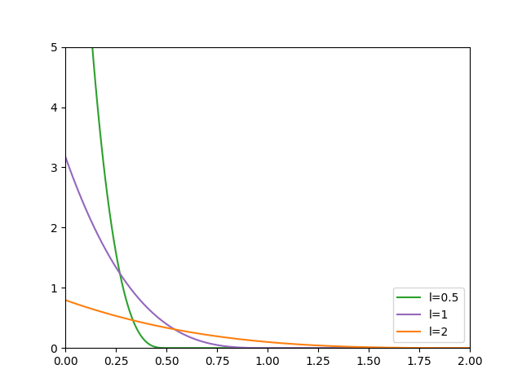
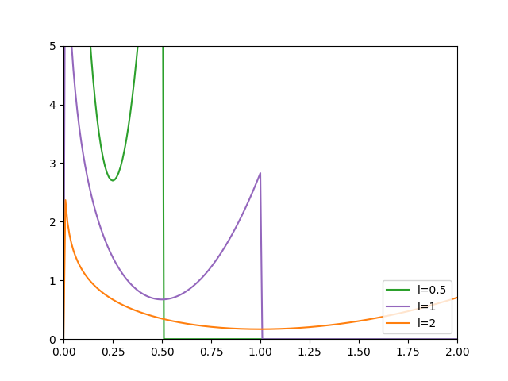
Smoothed Particle Hydrodynamics
Wpoly6
Wspiky
Wvisc

Slide 16
The algorithm

Slide 17
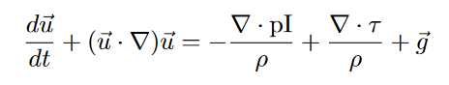
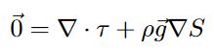
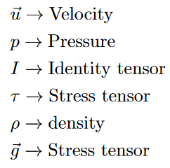
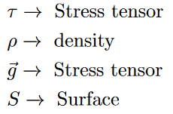
The viscosity
Glaciology
Stokes

Slide 18
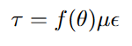
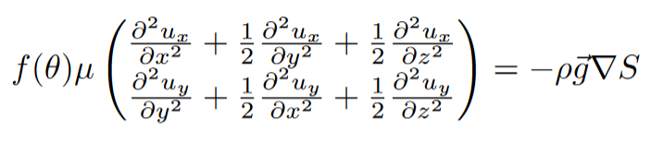
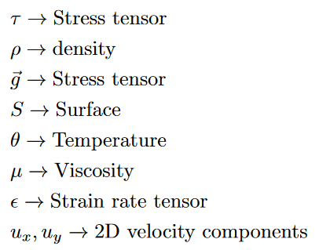
The viscosity
Volcanology

Slide 19
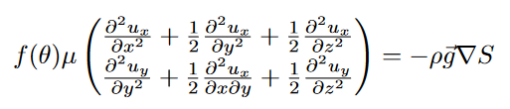
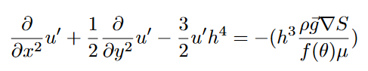
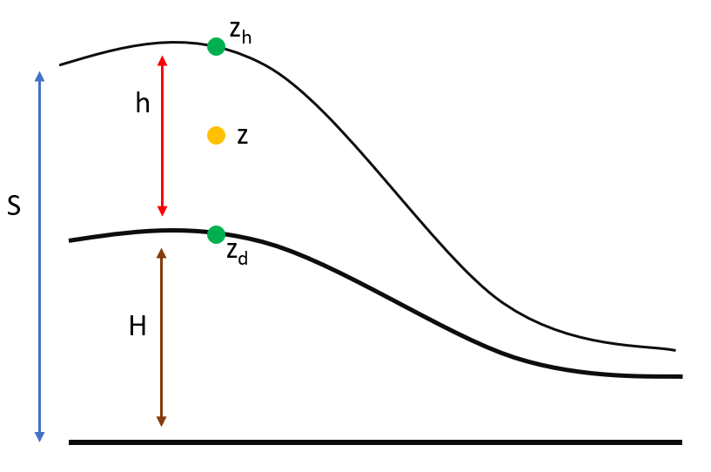
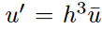
The viscosity
Integrate

Slide 20
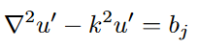
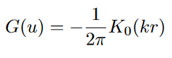
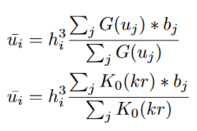
The viscosity
Known Equation

Slide 21
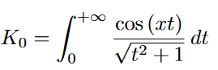
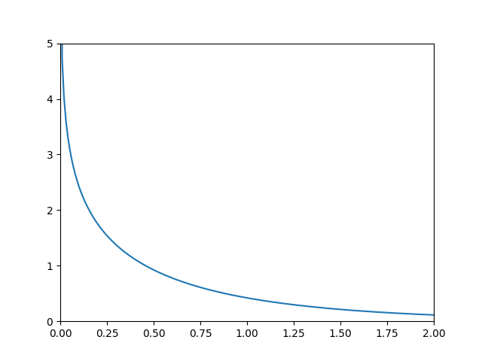
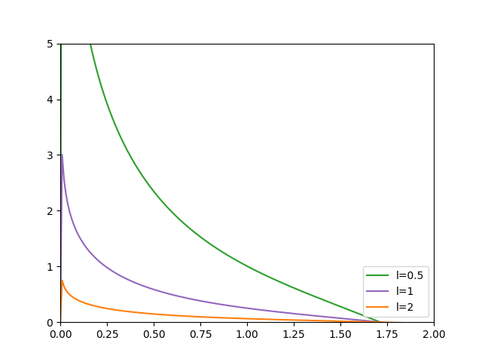
The viscosity
Modified Bessel function K₀
New smoothing kernel W_{new}

Slide 22
The algorithm

Slide 23
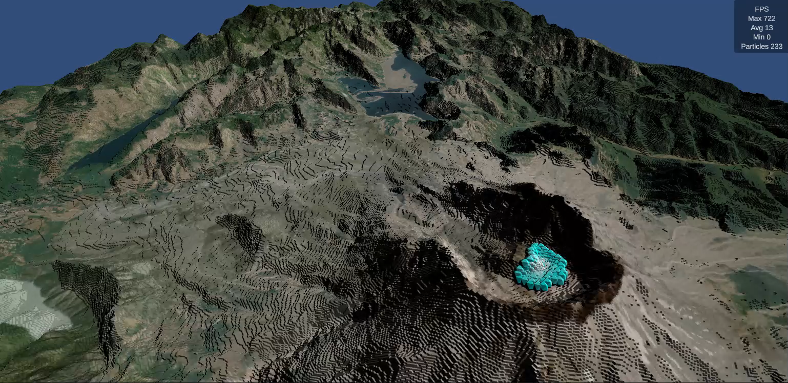
Final results
Simulation running in a NVIDIA RTX A6000, using Mount St.Helens topography

Slide 24
What’s next
Implement a validation model
Change the model for μ
Change the model for θ

Slide 25
Thanks for your attention

